Slide 1

Hash Tables
Data Structures
Dr. Bouchaib Falah

Slide 2
A Basic Problem
We have to store some records and perform the following:
add new record
delete record
search a record by key
Find a way to do these efficiently!

Slide 3
Unsorted array
Use an array to store the records, in unsorted order
add - add the records as the last entry fast O(1)
delete a target - slow at finding the target, fast at filling the hole (just take the last entry) O(n)
search - sequential search slow O(n)

Slide 4
Sorted array
Use an array to store the records, keeping them in sorted order
add - insert the record in proper position. much record movement slow O(n)
delete a target - how to handle the hole after deletion? Much record movement slow O(n)
search - binary search fast O(log n)

Slide 5
Linked list
Store the records in a linked list (unsorted)
add - fast if one can insert node anywhere O(1)
delete a target - fast at disposing the node, but slow at finding the target O(n)
search - sequential search slow O(n) (if we only use linked list, we cannot use binary search even if the list is sorted.)

Slide 6
More approaches
Have better performance but are more complex
Hash table
Tree (BST, Heap, …)

Slide 7
Array as table
studid
name
score
0012345
andy
81.5
0033333
betty
90
0056789
david
56.8
...
9801010
peter
20
9802020
mary
100
...
9903030
tom
73
9908080
bill
49
Consider this problem. We want to store 1,000 student records and search them by student id.

Slide 8
Array as table
name
score
0
:
:
:
12345
One ‘stupid’ way is to store the records in a huge array (index 0..9999999). The index is used as the student id, i.e. the record of the student with studid 0012345 is stored at A[12345]
andy
81.5
:
:
:
33333
betty
90
:
:
:
56789
david
56.8
:
:
:
:
:
:
9908080
bill
49
:
:
:
9999999

Slide 9
Array as table
Store the records in a huge array where the index corresponds to the key
add - very fast O(1)
delete - very fast O(1)
search - very fast O(1)
But it wastes a lot of memory! Not feasible.

Slide 10
Hash Tables
Goal: Perform insertion, deletion and search in constant time
O(1) !☺ Does not depend on n! (an Exception so far)
An ADT that uses a hash function to map identifying values, known as keys (e.g., a person's name), to their associated values (e.g., their telephone number).
Implementation: implements an associative array

Slide 11
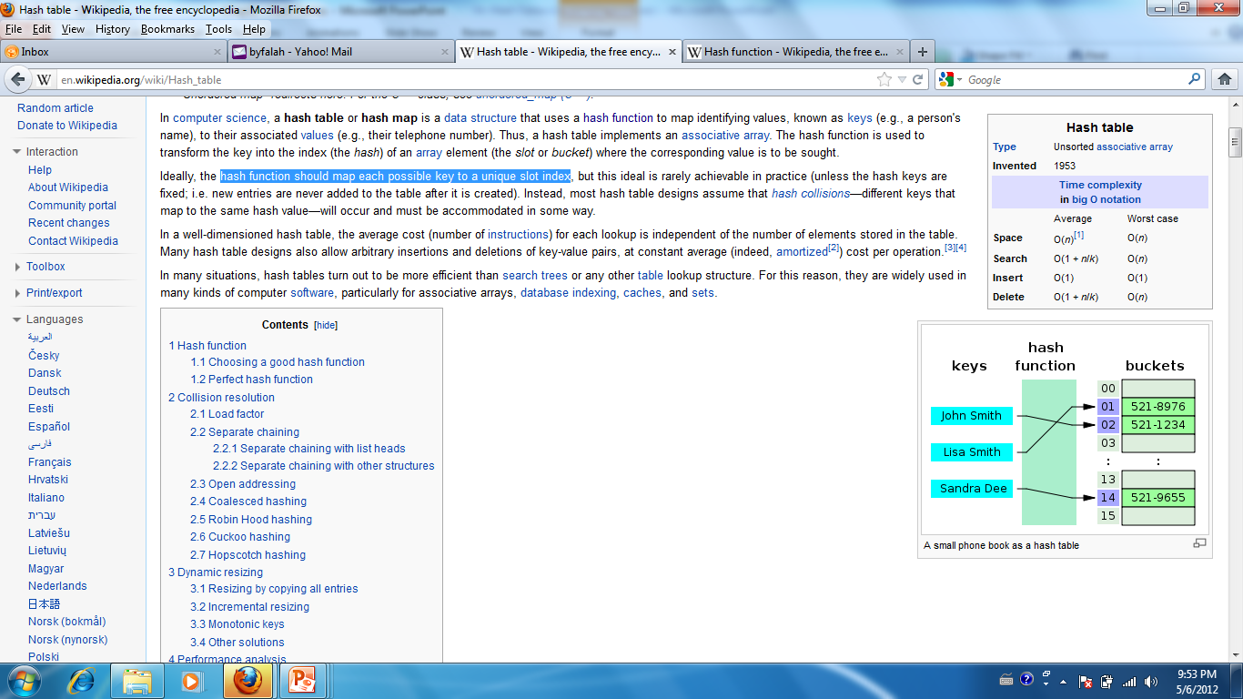
Hash Table Example
A small Phone book as a hash table

Slide 12
Hash Tables
Use Example:
Many compilers use Hash tables to implement their ‘Symbol tables’ (retrieving information about variables, functions, const …)
Critical to compiler speed
Languages that are often used to process symbols and text often have a built in hash table type!
Examples: Lisp, Perl, Python

Slide 13
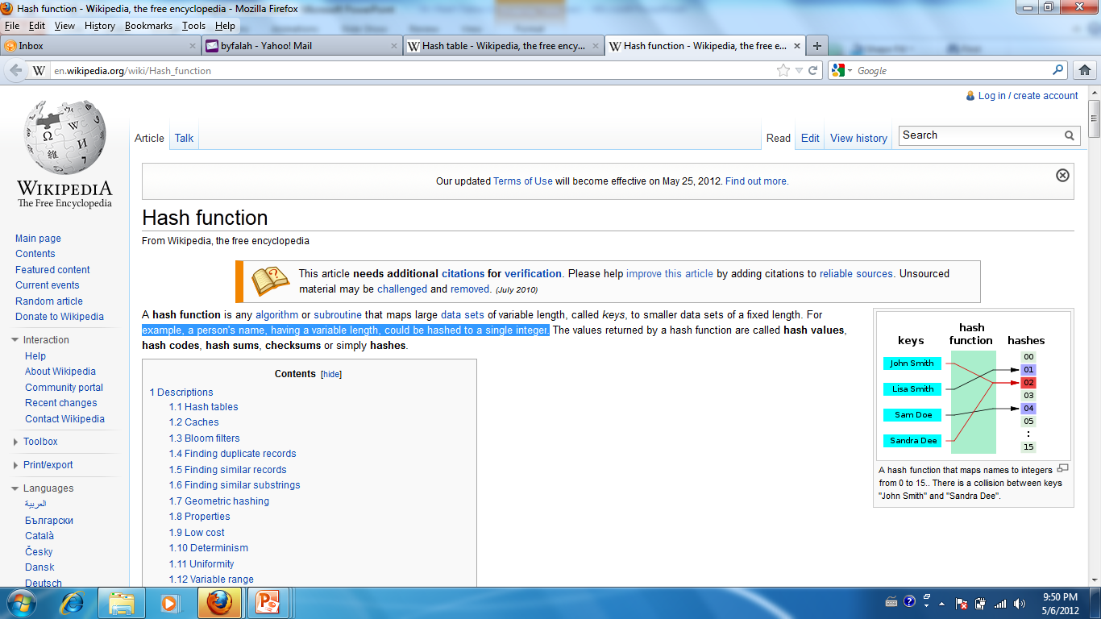
Hash Functions
used to transform the key into the index (the hash) of an array element (the slot or bucket) where the corresponding value is to be sought.
hash function should map each possible key to a unique slot index (not always possible in practice)
Example:
A person's name, having a
variable length, could be hashed
to a single integer.

Slide 14
Hash Functions
Depends a lot on the set of keys
Data type
The values used and their structure
Example: A postal code may contain 5 digits but the digits may have a special meaning:
the 1st digit is associated with (a) specific state(s)
The 2nd and 3rd digits designate a sectional center facility, the mail sorting and distribution center for an area.
The 4th and 5th digits represent a group of delivery addresses within that region
A HF written to help a post office sort out mail for delivery should not use the first three digits of the postal code because all mail will map to the same bucket (lots of collisions)!

Slide 15
Hash Functions
If key range too large, use hash table with fewer buckets and a hash function which maps multiple keys to same bucket:
h(k₁) = β = h(k₂): k₁ and k₂ have collision at slot β
Popular hash functions: hashing by division
h(k) = k%D, where D number of buckets in hash table
Example: hash table with 11 buckets
h(k) = k%11
80 → 3 (80%11= 3), 40 → 7, 65 → 10
58 → 3 collision!

Slide 16
Hash Tables: The Idea
Data Keys can be used to map directly to the correct table/array index
The key tells you where to look
This process of mapping (finding the location) is called ‘Hashing’
Performing arithmetic computations on keys to get an index (integer)
Hashing is done by a ‘Hash Function’
A hash function maps all possible values/keys into specific slots in the HT
The value returned by the hash function is called the hash of the key and is the index at which the record / data should be placed (the bucket).

Slide 17
Simple Example
An array of records (structures) where the key of the record is the index of the array.
The hash function is the identify function

Slide 18
Example 2: Class Hash
We want to represent our class using a HT!
Each student has a record
We select a representative key (e.g. Name, StudentID, birthDate)
It is better if the key is unique: StudentID
We need to find an ‘Adequate’ Hash Function that maps every key to the corresponding index in the array
If we have 30 students, we need only 30 buckets in the array
Attempt: Use the last 2 digits (x_{i} - between 0 and 99) of the studentID, and suggest the following HF:
F(x_{i}) = x_{i} % 30
Problem: What if 2 students are mapped to the same bucket?  Collision
The collision problem is worse if you start out with a non-unique key like last name.
Solving the problem  Collision Resolution

Slide 19
Example 3: Cryptography
Use a hash function to encrypt your passwords
Stored password in hashed form
Reversing the hash function is not obvious or easy or even possible
Every time you enter it, the password is hashed and the hash value compared to the stored hashed value

Slide 20
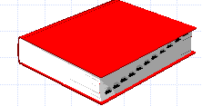
Example 4: Implementing a Dictionary
HF: Sum the ASCII codes for the letters then mod n (n is HT size!)
BAD and DAB would have the same key!
Another HF: to include the position of letters into account
Example?

Slide 21
Example 5: A ‘Spelling Checker’
Create a HT for all the words in a dictionary
When you encounter a word, whose spelling you want to check, just hash it and see if it exists in the table.
If it does, then you've spelled it correctly.
If not, then you haven't.
This allows you to look up a word in O(1) time rather than O(n) time, which, in a dictionary on the order of 800,000 words, is a big time saver…

Slide 22
Issues surrounding Hashing
What Hash Function to use?
Choosing the function is the biggest challenge
Should be easy to compute
If the ‘Hash Algorithm’ is too inefficient it will overshadow the advantages of the technique
Should distribute entries uniformly through the HT slots
use the table efficiently
Should minimize collisions

Slide 23
Can we avoid collisions?
No - Collisions are inherent!
Reasons for collisions:
Imperfect hash function
Changing data
The domain of the function (the data keys or part of the data keys) is usually larger than the range of the function (number of buckets)
Making the table have as many buckets as the domain of keys would be very inefficient because only a few of those keys will be used.

Slide 24
Hash Functions: Some Examples
Truncating:
F(x) = last N digits of K (the key) or first N digits (N depends on the size of the table)
Division (the most common)
F(x) = x % N
best results obtained if N, the tablesize is prime (experimental result)
Mid-Square:
Middle N digits in K² (N depends on the size of the table)
Folding:
Given a key x₁x₂… x_{r}
F1(x₁x₂… x_{r}) = x₁x₂+ x₃x₄…+ x_{r-1}x_{r}
F2(x₁x₂… x_{r}) = x₂x₁+ x₄x₃…+ x_{r}x_{r-1}
Example: x = 251367
F1(X) = 25 + 13 + 67 = 125
F2(X) = 52 + 31 + 76 = 159

Slide 25
Collision Resolution Policies
Definition:
If one of the ‘synonyms’ of a key x is already stored in the HT and another element y of the synonym set arrives. What should be the alternative entry in the HT?
2 methods:
Separate Chaining
Open Addressing (Rehashing)

Slide 26
Separate Chaining
A hybrid structure using arrays and linked lists:
Hash Table slots don’t hold data, rather they store pointers to the head of the linked lists.
Colliding records (‘synonyms’) are chained together in separate linked lists
If a collision happens, insert in the corresponding linked list:
Inserting at the head (push) is lowest cost - O(1)
Search/Delete cost: O(1) = constant time = (nax number of synonyms)
Drawbacks:
Use of another Data Structure,
Linear search through the Linked Lists: constant factor for search/deletion can get large if list is long

Slide 27
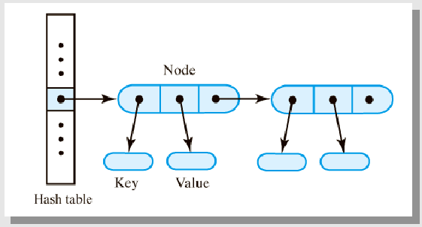
Separate Chaining (Cont.)

Slide 28
Rehashing – Meaning 1
The operation of:
Allocating a larger hash table HT2
Taking all the elements in HT1 and hashing them into HT2
Performed when performance in HT1 deteriorates too much or cannot be sure that a place will be found
Table too full
Too many deletions interspersed with insertions
Expensive operation O(N) but happens infrequently
Built-in hash-table types:
Sometimes can specify by how much new HT grows when it gets too full
System determines when the table is too full

Slide 29
Open Addressing
No linked lists, all items are stored in the same HT
Alternative cells ( h₀(k), h₁(k), .., h_{n}(k)) are tried till an empty cell is found.
Each try is called a ‘Probe’
h_{i}(k) = ( hash(k) + f (i) ) % tablesize
hash(k) is the original hash function
the f(i) function is the collision resolution strategy or rehash function
Since each cell in the HT can hold only one item. A bigger table is needed than in chaining
Generally, HT Size >= 2N

Slide 30
Open Addressing
The type of rehash function or collision resolution strategy gives rise to different methods:
Linear Probing
Quadratic Probing
Double Hashing

Slide 31
Linear Probing
FUNCTION: h_{i}(k) = ( h(k) + f (i) ) % tablesize
In this method, f(i) is linear in the probe number i, e.g. f(i) = ci (typically c = 1)
Insertion: If collision happens at HT[h(k)], look successively at h(k)+c, h(k)+2c, …. , ci
If end of the table is reached, loop back to the beginning (via the % tablesize)
f(i) could use another constant c other than 1
In general, any rehash function f(j) = (j + c ) % tablesize [=> f(i) = (c*i)%tablesize ] where j is the previous probe result and such that c and tablesize are relatively prime (they cannot be both divided evenly by an integer except 1) produces successive values that cover the whole table.

Slide 32
Linear Probing: Search and Insertion Algorithm:
Compute h(k)
If HT[h(k)] is empty
Search: Return appropriate value for “does not exist”
Insertion: Return position of the empty slot
If HT[h(k)] is full, compare k to key stored at HT[h(k)]:
If equal:
Search: return element found
Insertion: handle duplicate
If not equal, perform a “circular linear search” through successive buckets as given by the rehash function, going back to the beginning of the hash table if reach the end and haven’t searched the whole table:
Search:
If reach element with the given key, than return it
If reach an empty slot, then return an appropriate value for “does not exist”
Insertion:
If reach element with the given key, then handle duplicate
If reach an empty slot, then return its position

Slide 33
Drawback of Linear Probing
PROBLEM: Elements tend to cluster around full slots! Why?
At first, it is equally likely that a random record will be placed at any given empty slot in the table
As more entries are inserted and more hash clashes resolved, more keys will get hashed into the same slot because of rehashing
Primary clustering is the tendency to create long sequences of filled slots. Two keys that hash into different values compete with each other in successive rehashes.
Primary clustering results in very long probes.
If there is a lot of linear probing, efficiency becomes O(n) in worst case (you look at all elements in the table)
We’ve lost the advantages of hashing!
This happens if we let the table get nearly full (over 75% full is bad news)
The probability of each slot being already full is equal to the load-factor of the hash-table (stored items / available positions). As the factor approaches 1.0 so does the chance that the next slot in the probing sequence will be full, this degrades performance of the hash-table to linear time.
SOLUTION: Allow the rehash function to depend on the number of times that the function is applied to a particular hash value

Slide 34
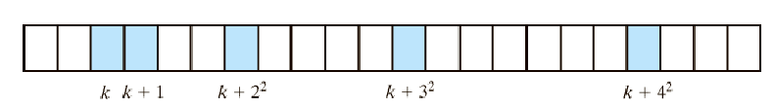
Quadratic Probing
FUNCTION: h_{i}(k) = ( h(k) + f (i) ) % tablesize
f(i) is quadratic in the number of the probe, e.g. f(i) = i²
Quadratic probing eliminates Primary Clustering problem by probing separated slots
If collision happens at HT[h(k)], look successively at h(k)+1², h(k)+2², … till empty cell found
Theorem: Guarantees finding an empty slot when the tablesize is prime and the table is half empty.

Slide 35
Drawback of Quadratic Probing
PROBLEM: Quadratic probing solves the Primary Clustering problem BUT different keys that hash to the same value will follow the same probe/rehash path (probe the same alternative buckets).
This phenomenon, secondary clustering, delays the resolution of the collision.
Experimentally, this seems to be a smaller problem than Primary Clustering
SOLUTION: Eliminate the use of the same rehash path by using a different hash function for collision resolution/rehashing

Slide 36
Double Hashing
Avoids both Primary Clustering and Secondary Clustering
IDEA: The probe/rehash function should depend on the key instead of being the same for all keys
Use a second hash function h₂ (applied only if the first hash function, h₁, finds a slot that is already filled)
h(k) = ( h₁(k) + h₂(k) ) % tablesize
If that slot is already filled, generalize: h(k) = rh ( i, k ) % tablesize
where rh is the increment and is defined as: rh( j , k ) = ( j + h₂(k) )% tablesize where j = h₁(key) the first time (probe number i = 0) j = previous value of rh for further probes ( i > 0) The rh function is applied until an empty position is found
Alternative formulation, where i = probe number:
h(k,i) = ( h₁(k) + h₂(k) * i ) % tablesize
The probe sequence still searches the table in a linear order, starting at the location h1(k), but a second hash function h2 determines the size of the steps taken, depends on the key and is independent of h1.

Slide 37
Double Hashing (cont.)
SO: h(k,i) = h₁(k) + h₂(k) * i
Where i is the probe number
When i = 0, h(k,i) = h₁(k) (no collision)
h₂(key) needs to be computed only once for each key
Choose h₁ and h₂ that minimize clustering (not always easy)

Slide 38
Double Hashing (cont.)
h₂ should:
Depend on the key – that’s what makes this double hashing
Be different from h₁. Why?
Different means: h₂(key₁ ) != h₂(key₂ ) even if h₁(key₁ ) == h₁(key₂ )
Not return zero. Why?
Example: h₁(key) = key % tablesize h₂(key) = 1 + key % (tablesize – 1) , where:
tablesize is prime

Slide 39
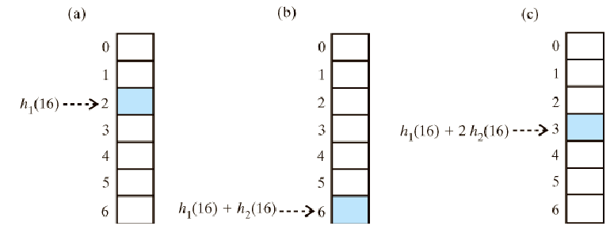
Double Hashing (cont.)
Ideal functions are of this format:
h₂(key) = const – (key % const)
Where const is a prime number less than tablesize
Example: (const = 5)

Slide 40
Deletion in Hash Tables
Difficult in HTs that use open addressing for search and insertion
If two records r1 and r2 hash to the same place and r2 is rehashed
Deleting r1 leaves an empty space
Searching for r2 finds an empty space : r2 is not in the table!
Solution: lazy deletion, that is, leave the element in but mark it deleted
Works when not many deletions
Otherwise an unsuccessful search will require a search through the entire table because most positions will be marked deleted rather than empty
Would prefer a deletion algorithm that does not cause retrieval time to depend on number of deletions!

Slide 41
Separate Chaining Vs. Open Addressing
If your data will expand (or decrease) over time OR unknown amount of data:
➔Separate Chaining
If your data is not expanding or shrinking much, known amount of data:
➔ Open Addressing
Collision resolution with Open Addressing:
Double Hashing is better than probing.

Slide 42
Conclusions
Hash tables: a fast way of accessing information
Presents some difficulties in implementation
Popular data structure implemented in some languages and/or language libraries
Of course, many variations on hashing including extendible hashing, which is used when data cannot be stored in memory but must be located on disk.

